Slide 1

COURSE: B.Sc. (PROGRAMME) IN ECONOMICS
PAPER NAME – MICROECONOMICS II
TOPIC – EQUILIBRIUM OF FIRM UNDER PERFECT COMPETITION
YEAR- THIRD SEMESTER-5 SESSION -2022-2023
DATE OF LECTURE: 29/07/2022
PREPARED BY
DR. KAMALIKA CHAKRABORTY
ASSISTANT PROFESSOR (DEPARTMENT OF ECONOMICS)
KHATRA ADIBASI MAHAVIDYALAYA, BANKURA, WEST BENGAL

Slide 2
Features of Perfect Competition
A Large Number of Buyers and Sellers
Buyers and Sellers are Price Takers
Homogeneous Products
The firms are Free to Entry or Exit the industry
No Individual Preferences (buyer/seller)
Each buyer and seller operates under the conditions of certainty
Mobility of Factors of Production–factors move freely from industry to industry and firm to firm
Buyers and sellers have perfect information about the market
There are no transport costs and advertisement expenditure

Slide 3
Short run Equilibrium of firm under Perfect Competition
Conditions for equilibrium of the firm are:
i) P=MC
ii) MC must be rising at the point of equilibrium
In short run firm may earn supernormal profit (Total Revenue > Total Cost), Normal Profit (Total Revenue = Total Cost) or incur loss (Total Cost> Total Revenue).

Slide 4
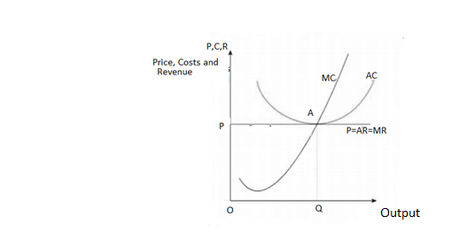
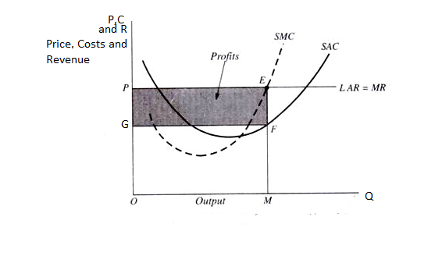
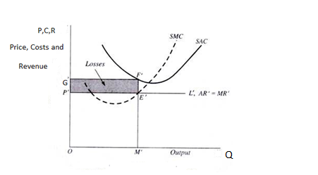
Short run Equilibrium of firm under Perfect Competition(contd.)
Fig 1: Short run Equilibrium with Supernormal Profit
Fig 2: Short run Equilibrium with normal profit
Fig 3: Short Run Equilibrium with Losses

Slide 5
Long run Equilibrium of firm under Perfect Competition
In the long run only those firms will remain in the market who earn normal profit.
Each firm of the industry will be in equilibrium if the following two conditions are satisfied:
(1) In equilibrium, its short-run marginal cost (SMC) must equal to its long-run marginal cost (LMC) as well as its short-run average cost (SAC) and its long-run average cost (LAC) and both should be equal to MR=AR=P. Thus, the first equilibrium condition is:
SMC = LMC = MR = AR = P = SAC = LAC at its minimum point, and the second equilibrium condition is
LMC curve must cut MR curve from below.

Slide 6
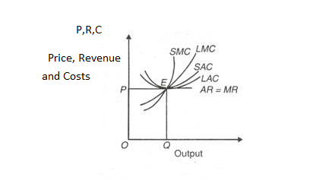
Long run Equilibrium of firm under Perfect Competition(contd.)
Fig 4: Long Run Equilibrium of Firm

Slide 7
THANK YOU

